Slide 1

The danger of Complacency
TEXT: JOSHUA 18 VS 2-6

Slide 2
Question 1 what is the meaning of complacency

Slide 3
To be complacent is to have a feeling of quiet pleasure, contentment, or satisfied with oneself
satisfied with how things are and not wanting to change them.
It comes with lack of zeal and dedication in laying claim to God’s wonderful gifts.

Slide 4
Identify complacency in the following passages;
Joshua 18 vs 2-3 lack of Motivation
Proverb 24 vs 30-31Laziness and alway giving excuses
11 kings 20 vs 12-19 a false sense of security
Luke 8 vs 14 they lack spiritual maturity
James 1 vs 22-23 they are indifferent to God’s word
Rev 3 vs 14-19 they are lukewarm
Acts 24 vs 16 they lack self examination
Proverb 29 vs 18 they lack foresight

Slide 5
Identify complacency in the following passages;
Joshua 18 vs 2-3
Proverb 24 vs 30-31
11 kings 20 vs 12-19
Luke 8 vs 14
James 1 vs 22-23
Rev 3 vs 14-19
Acts 24 vs 16
Proverb 29 vs 18

Slide 6
IDENTIFY WHY PEOPLE BECOME COMPLACENT FROM THE FOLLOWING BIBLE PASSAGES.
NUMBERS 21: 4-5 Discouragement caused by failure
PROV13 VS 12 Delay in fulfilment of desires
NEH 4 VS 10 Difficulty of impending task
ROMANS 12 VS 3 Unhealthy self image
GAL 3 VS 28 Feeling of inferiority
1 JOHN 2 VS 15 Worldly pleasure
MATT 6 VS 33 Little material possession
REV 3 VS 17 Achievements
2 SAM 11 2-17 Lack of repentance

Slide 7
Identify the Dangers of Complacency from the following bible passages.
Heb 10 vs 24 Neglecting fellowship with the Lord and Brethren
Heb. 5 vs 14 Slow or delayed progress
Exo 1 vs 14 Bondage
1 Sam 2 vs 7 Poverty
2 Cor 2 vs 5 God’s Judgment
Gen 49 vs 3-4 Lack of God’s Fulfillment in life
2 Sam 12 vs 10-14 Injured Conscience

Slide 8
 | How it affects the believer's Life |  | Steps to guard against it
1 |  | 1
2 |  | 2
3 |  | 3
4 |  | 4
5 |  | 4

Slide 9
PRAYER:
PRAY AGAINST BEING AT EASE IN ZION
AMOS 6 VS1 WOE TO THEM THAT ARE AT EASE IN ZION. THAT SHALL NOT BE YOUR PORTION IN JESUS NAME AMEN.

Slide 10
Question 9. Do you faithfully pay your tithe?.
Malachi 3 vs 10a ‘’Bring ye all the tithes into the store house, that there may be meat in the house...’’

Slide 11
Question 10 Journaling:
How often do you write down eachings, insigts from your personal studies, revelations, Rhema words from God.
Habakkuk 2 vs 1-3
‘’Write down the revelation and make it plain on tablets so that a herald may run with it. For the revelation awaits an appointed time. It speaks of the end and will not prove false’’

Slide 12
Keep your scoring in view and strife to improve, and to also grow into a matured Christian in 2014. God Bless.
Amen

Slide 13
TOOLS FOR SOUL WINNING
GOD equips and empowers anyone HE calls. He promised to be with anyone HE calls, Matt 28:19-20, Matt 10:1. The primary requirement for soul winning is to be born again. HE called the eleven first to be with HIM before the assignments Mark 3:13- 15. Here are some of the tools required to be an effective soul winner:
To be filled with the HOLY SPIRIT - Acts 1:8, 1 Tim 3:16
A good knowledge of the word of GOD is essential Joshua 1:8 and Psalm 1:1-6
Compassion and genuine concern for the salvation of souls Matt. 9:36
Faith that GOD can save any and all souls – Jer 32:27
Zeal to go out for souls – 1 Cor 9:22
Prayers to break limiting barriers and obstacles – Rom 10:1
Wisdom to respond to issues raised – Dan 12:3, John 4: 7- 30
Sacrifice of personal rights and privileges – 1 Cor 9:19-20
Patience to get souls yield to the truth. Do not give up!
Holy living to show the way by what you do and not just what you say.

Slide 14
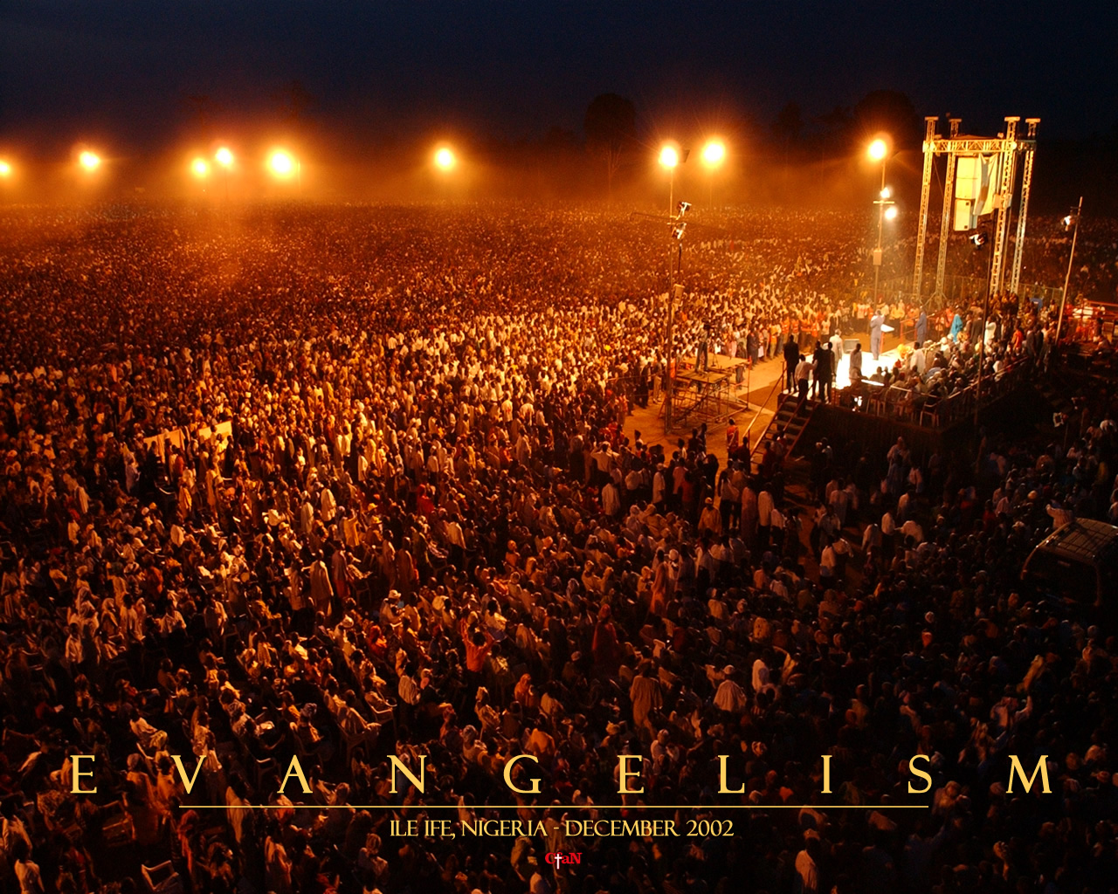

Slide 15
Summary
GOD has called and equipped us to go and win souls
Labourers are needed – Roman 10:13 – 15
“¹³ For whosoever shall call upon the name of the Lord shall be saved.
¹⁴ How then shall they call on him in whom they have not believed? and how shall they believe in him of whom they have not heard? and how shall they hear without a preacher?
¹⁵ And how shall they preach, except they be sent? as it is written, How beautiful are the feet of them that preach the gospel of peace, and bring glad tidings of good things!”
Conclusion
GOD is a rewarder Heb 11:6, and will not forget our labour of love. The servant who knows the master’s will but fails to do it will be beaten with many stripes Luke 12:47. You and I have our choices.
Pray with Luke 10: 1- 2

Slide 16
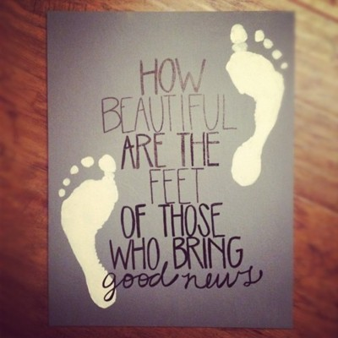

Slide 17

“But though we, or an angel from heaven, preach any other gospel unto you than that which we have preached unto you, let him be accursed “ Galatians 1:8

Slide 18
May the LORD bless you as you keep HIS word
Amen

