Slide 1

Embrace the change
Memory Verse: “Therefore, if anyone is in CHRIST, he is a new creature, old things are passed away, behold all things have become new” 2 Corinthians 5:17

Slide 2
Bible Text: Acts 2:41-47
⁴¹ Then they that gladly received his word were baptized: and the same day there were added unto them about three thousand souls.
⁴² And they continued steadfastly in the apostles' doctrine and fellowship, and in breaking of bread, and in prayers.
⁴³ And fear came upon every soul: and many wonders and signs were done by the apostles.
⁴⁴ And all that believed were together, and had all things common;
⁴⁵ And sold their possessions and goods, and parted them to all men, as every man had need.
⁴⁶ And they, continuing daily with one accord in the temple, and breaking bread from house to house, did eat their meat with gladness and singleness of heart,
⁴⁷ Praising God, and having favour with all the people. And the Lord added to the church daily such as should be saved.

Slide 3
Lesson introduction:
A child of GOD needs to adjust to a new life after salvation. This explains the point that if anyone in JESUS CHRIST is a new creature and old things must pass away in his/her life. 2 Cor. 5:17
The old things include relationships, attitudes, habits, and all areas of life. The child of GOD must have a standard that he/she looks forward to.
There must be a goal that he/she aspires to attain in the new found life. It is our prayer that the LORD will open our eyes to treasures in HIS word in the name of JESUS CHRIST, Amen.

Slide 4
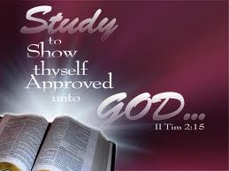
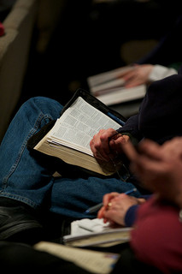

Slide 5
Objectives of this lesson
At the end of this lesson, we should be able to
adjust where necessary at least for the purposes of fellowshipping with one another
make a decision to start fellowshipping with one another where we had not in a more purposeful way
Hebrews 10:25
Don’t stop meeting together with other believers, which some people have gotten into the habit of doing. Instead, encourage each other, especially as you see the day drawing near.
(Common English Bible (CEB))
Not forsaking or neglecting to assemble together [as believers], as is the habit of some people, but admonishing (warning, urging, and encouraging) one another, and all the more faithfully as you see the day approaching. (Amplified Bible (AMP))

Slide 6


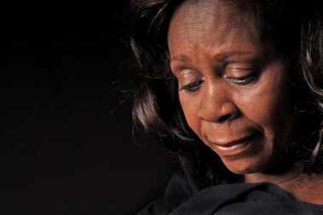
Text review 1
Where believers are warned, urged and encouraged, some if not many take offence why?

Slide 7
JESUS CHRIST ON OFFENCES
Luke 17:1

Slide 8

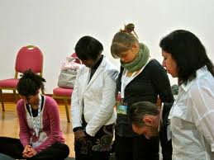
Text review 2
Four major Christian behaviours are essential in the process of abiding after salvation. They are:
Continuity in Apostles Doctrines
Continuity in fellowship
Continuity in breaking of bread
Continuity in prayers

Slide 9
These four (4) behaviours were exhibited STEADFASTLY by the apostles and the result were tremendous and glorious as follows:
Signs and wonders
Unity of purpose
Lack of needs
Gladness (joy of salvation)
The LORD’S NAME was glorified and
There was expansion in the Church

Slide 10
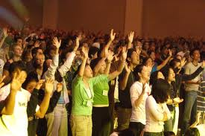

Slide 11
Make necessary adjustments
GOD has a task for every one of HIS children and these are backed up with appropriate rewards because HE rewards those who diligently seek HIM, Heb.11:6
For example, HE appointed Joshua as the successor of Moses and said HE would give him everywhere the sole of his feet touched – Josh 1:1-6. A responsibility is therefore placed on the believer to so whatsoever GOD commands. Some of the commands include the following:

Slide 12
Pray without ceasing, 1 Thess 5:17. JESUS CHRIST said, “when you pray” not if you pray, Matt. 5:5-7
Evangelism, Matt 28:19-20, Acts 1:8
Live a holy life, Matt 5:48. We can add to the list. GOD is always with the obedient so that they do not perish, GOD does not have pleasure with the disobedient so they fall and perish. The wicked only seem to prosper for a while – Psalms 73:3, 16-20
We should always obey GOD because HE does not have great delight in burnt offerings and sacrifices – 1 Sam. 15:22

Slide 13
As you adjust to a new life in CHRIST, in absolute obedience to the will of GOD, always ask;
Is the LORD’S name glorified in my new lifestyle? 1 Cor 10:31
Will my actions disturb my fellowship with GOD? 1John 2:15-17
Would GOD have done this? 1 Peter 2:21
Can I take this particular action if GOD is physically present? Psalms 139:7-10, Jer 23:23-24. A major cause of sinful habits is because people do not realise that GOD is omnipresent.

Slide 14
Fellowship with other Christians
GOD forbid believers from forsaking the company of others believers Heb. 10:25
Such fellowship helps believers to build up a good conduct or behaviours, which are capable of making them a good example to others 1 Tim 4:12
Fellowship with believer will prevent from entering into wrong company of sinners and thereby getting polluted Act 11:26
Fellowship with believer will eventually lead a young believer to become matured, bible believing and Holy Christian who the Bible refers to as saints. Acts 17:1-11 and Rom 1:7
It creates accountability Galatians 6:1-5; Luke 17:3

Slide 15
conclusion
Adjust to your new found faith through constant fellowship and absolute obedience.

