Slide 1

VICTORY CENTRE
SWINDON
SUNDAY SCHOOL
14 APR 13

Slide 2


Slide 3
The aim of this lesson is for us as children of God to have an in depth knowledge of heaven while we are still on earth.
AIM

Slide 4
OBJECTIVE
The objective is to ensure that by the end of this lesson you will know and understand
What heaven is
What heaven looks like
Those who are presently in heaven
Those who will not make heaven at all
And decide to enter into heaven at the end of your race on earth.

Slide 5
BIBLE PASSAGE
Revelation 21: 1 – 18
Memory Verse
2 Corinthians 5:1
Notes:
Revelation 21:1-18
New International Version (NIV)
A New Heaven and a New Earth
21 Then I saw “a new heaven and a new earth,”^{[a]} for the first heaven and the first earth had passed away, and there was no longer any sea. ² I saw the Holy City, the new Jerusalem, coming down out of heaven from God, prepared as a bride beautifully dressed for her husband. ³ And I heard a loud voice from the throne saying, “Look! God’s dwelling place is now among the people, and he will dwell with them. They will be his people, and God himself will be with them and be their God. ⁴ ‘He will wipe every tear from their eyes. There will be no more death’^{[b]} or mourning or crying or pain, for the old order of things has passed away.”
⁵ He who was seated on the throne said, “I am making everything new!” Then he said, “Write this down, for these words are trustworthy and true.”
⁶ He said to me: “It is done. I am the Alpha and the Omega, the Beginning and the End. To the thirsty I will give water without cost from the spring of the water of life. ⁷ Those who are victorious will inherit all this, and I will be their God and they will be my children. ⁸ But the cowardly, the unbelieving, the vile, the murderers, the sexually immoral, those who practice magic arts, the idolaters and all liars—they will be consigned to the fiery lake of burning sulphur. This is the second death.”
The New Jerusalem, the Bride of the Lamb
⁹ One of the seven angels who had the seven bowls full of the seven last plagues came and said to me, “Come, I will show you the bride, the wife of the Lamb.” ¹⁰ And he carried me away in the Spirit to a mountain great and high, and showed me the Holy City, Jerusalem, coming down out of heaven from God. ¹¹ It shone with the glory of God, and its brilliance was like that of a very precious jewel, like a jasper, clear as crystal. ¹² It had a great, high wall with twelve gates, and with twelve angels at the gates. On the gates were written the names of the twelve tribes of Israel. ¹³ There were three gates on the east, three on the north, three on the south and three on the west. ¹⁴ The wall of the city had twelve foundations, and on them were the names of the twelve apostles of the Lamb.
¹⁵ The angel who talked with me had a measuring rod of gold to measure the city, its gates and its walls. ¹⁶ The city was laid out like a square, as long as it was wide. He measured the city with the rod and found it to be 12,000 stadia^{[c]} in length, and as wide and high as it is long. ¹⁷ The angel measured the wall using human measurement, and it was 144 cubits^{[d]} thick.^{[e]} ¹⁸ The wall was made of jasper, and the city of pure gold, as pure as glass.

Slide 6
LESSON OUTLINE
What is heaven?
How big is heaven?
What is heaven like?
Who are the inhabitants of heaven?

Slide 7
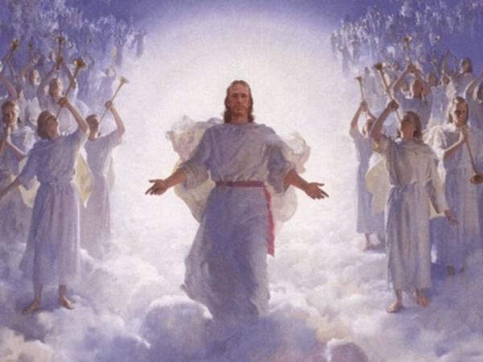
What is heaven?
Heaven is the home of our lord God. MATT 6:9, 2 Cor. 12:2
The atmosphere and outer space. Exo. 32:13, Neh. 9:6
It is paradise, the place of the stars. Gen 1:14-18
Kingdom of God and of Christ. Eph 5:5
The fathers house with many mansions. John 14:2
A place of rest. Heb 4:9
Building of God not man made. 2 Cor 5:1
Notes:
New International Version (©2011) Matt 6:9
"This, then, is how you should pray: "'Our Father in heaven, hallowed be your name

Slide 8
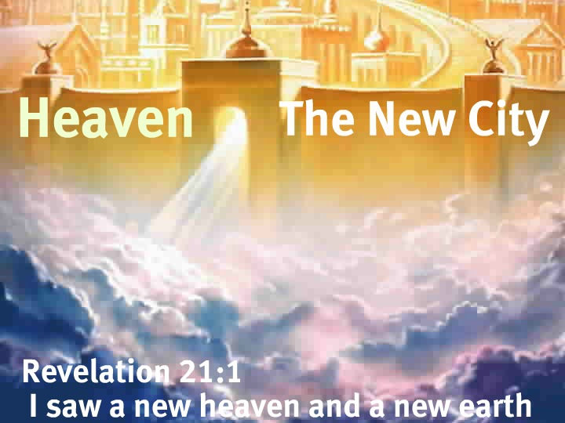
How big is heaven?
Heaven cannot be measured. Jer 31:37
Heaven is bigger than the New Jerusalem, NJ is only a part of Heaven. Rev 21:2,10
Heaven has many mansions which are for believers who through faith in Christ have overcome.
Notes:
New International Version (©2011) Jer 31:37
This is what the LORD says: "Only if the heavens above can be measured and the foundations of the earth below be searched out will I reject all the descendants of Israel because of all they have done,“
New Living Translation (©2007)
This is what the LORD says: "Just as the heavens cannot be measured and the foundations of the earth cannot be explored, so I will not consider casting them away for the evil they have done. I, the LORD, have spoken!
English Standard Version (©2001)
Thus says the LORD: “If the heavens above can be measured, and the foundations of the earth below can be explored, then I will cast off all the offspring of Israel for all that they have done, declares the LORD.”

Slide 9
Group Activity
In your groups, you are to draw a distinction between heaven and your family compound. (3mins)

Slide 10
What is heaven like?
Heaven is a high place. Isa 57:15
Heaven is a holy and happy place. Psalm 20:6, Rev 7:17
Heaven is a place without death, liars, sorrow, crying and pain. Rev 21:4
There is no night or darkness in heaven. Rev 22:3-5
There is no hunger, thirst, excessive heat/cold in heaven.
Heaven is a place of comfort and satisfaction.
There is no sickness in heaven
There is righteousness in heaven
There are no curses in heaven
God is the ruler in heaven
Believers shall be in perfect communion with God
There is glory that cannot be described in heaven
Heaven is everlasting.

Slide 11
Group Activity
Group 1 & 2
you are to make a list of those who are already in heaven according to the bible and what we need to do in order to make heaven(3mins)
Group 3 & 4
you are to make a list of those who can never be in heaven according to the bible and what we need to do in order not to be deprived of heaven(3mins)

Slide 12
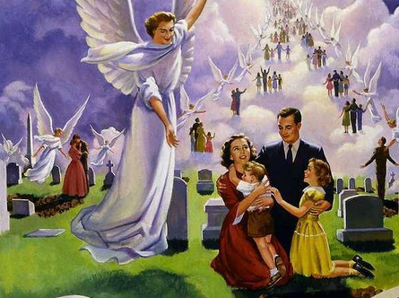
Who are the inhabitants of heaven?
God the father. Matt 6:9
Jesus Christ our Lord. Acts 3:20-21
Enoch, Moses and Elijah. Gen 5:24, Matt 17:3
Angels of God
All those who have died trusting in Jesus. 1Thess 4:14

Slide 13
Who will not make heaven?
The devil. Rev 20:10
Thieves. Lk 12:33
The cowardly, the unbelieving, the vile, the murderers, the sexually immoral, those who practice magic arts, the idolaters and all liars. Rev 21:8
Anyone in whose life is found the works of the flesh. Gal 5:19-21
Notes:
But the cowardly, the unbelieving, the vile, the murderers, the sexually immoral, those who practice magic arts, the idolaters and all liars

Slide 14
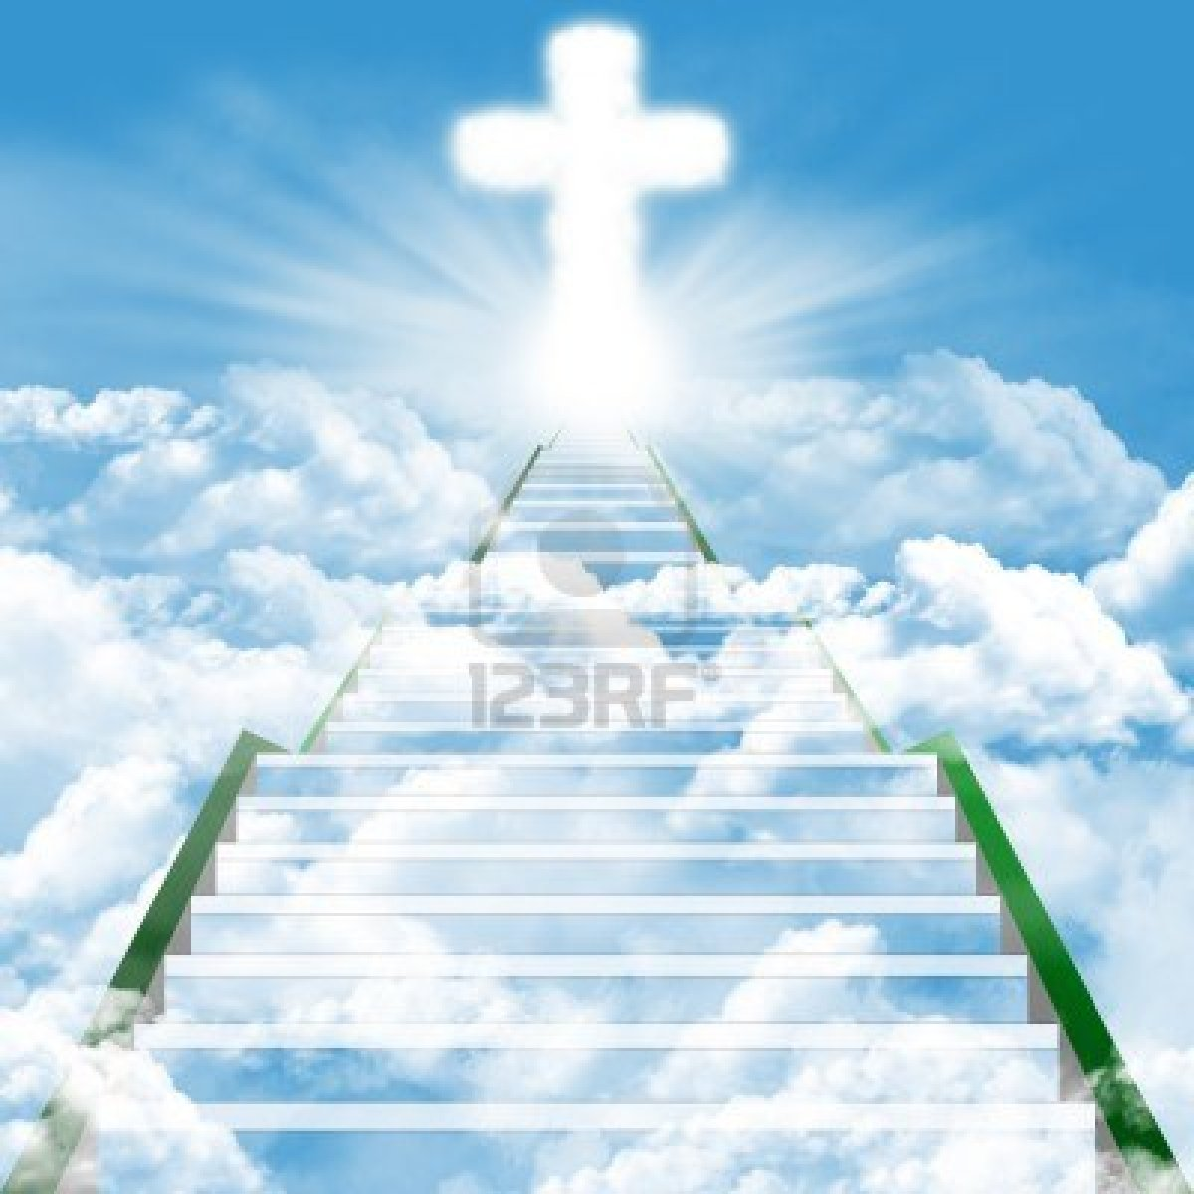
QUESTIONS?

Slide 15
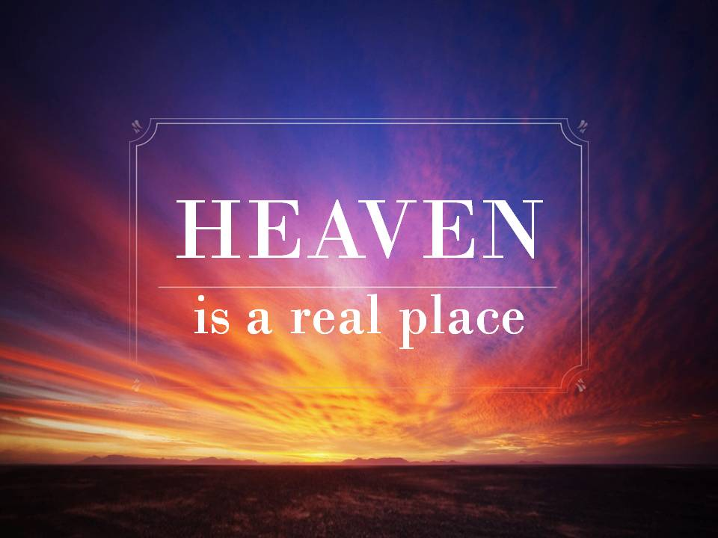
Summary
Heaven is extremely beautiful, it is the final destination for believers who are able to endure to the very end.
No believer should miss it.
Notes:
PRAY A SHORT PRAYER THAT GOD WILL GRANT EVERY BELIEVER THE GRACE TO ENDURE TO THE END.

Slide 16
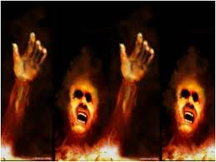
Look forward to next week SS lesson on HELL

